Slide 1
MTH1W
Diagnostic Thinking Task
Integers

Slide 2
Teacher Notes
FACILITATING THE DIAGNOSTIC:
Slides with a grey background should not be shown to students.
The purpose of this diagnostic is to learn more about what students recall and what their comfort level is with various concepts. This is NOT a test.
It is HIGHLY recommended that this tool be used in the following ways:
Provide 1-3 problems to students at a time for a short part of the period
Emphasize that you want to learn about what they remember - this is NOT a reflection on them
Emphasize that you want to learn how they think, so the visuals and explanations they give for their thinking will be really helpful to you
Paper Approach: Provide each student with a paper copy of the selected questions (e.g., slides 3-5 on the first day and slides 6 and 7 on the next). Provide two-sided counters or algebra tiles (for integer pieces) to students if needed.
Digital Approach: Provide students with a copy of the slides (only the problem slides) via Google Classroom or your VLE. Have students show their thinking digitally or by inserting pictures onto the slides. If necessary, describe how to use the arrows and counters digitally if you are doing the diagnostic that way. Note: You can stretch the arrows to the appropriate length or you can make copies of the arrows and keep them unstretched. It is better if students do not use calculators and instead show other ways of thinking about number.
For either approach, circulate / give students the explicit option of verbally explaining/showing their thinking to you instead of recording it on paper. Avoid confusion based on running the technology. Sometimes paper / writing by hand on a whiteboard can give you more information than trying to figure out how to do something with the technology. Make notes about observations to use for future record-keeping.
ASSESSING THE DIAGNOSTIC:
Observe where students have difficulty and make notes on the MTH1W Developmental Continuum (Integers tab) for each student. Use the look fors to help guide your observations. These notes will help you identify what you can reteach to close gaps in skills and concepts, differentiate instruction as needed, and provide intervention.
FOLLOW-UP STRATEGIES AND RESOURCES
Suggestions for how to differentiate instruction, close gaps and skills and provide intervention are provided here.

Slide 3
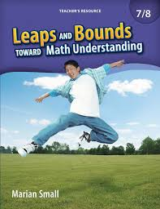
SOME BACKGROUND:
WHY MIGHT STUDENTS STRUGGLE WITH INTEGERS
They might...
be confused with comparing integers (e.g., students might think -40 > -3 since 40 > 3)
have difficulties with whole number operations that affect their ability to operate with integers
struggle with the use of the - sign for both negative integers and subtraction, and the use of the + sign for both positive integers and addition
consider subtraction only in terms of take-away, making it difficult to model the subtraction of a negative number on a number line
confuse how to handle the signs for subtracting than for adding because the “rules” are different (e.g., for 5 + (-3), you use the sign of the integer farthest from 0 for the answer, but for 3 - (-5), you don’t)
over-generalize some relationships with signs (e.g., since 4 - (-3) is the same as the positive amount 4 + 3, students might think that 2 negatives make a positive when adding -4 and -3)
Notes:
From WRDSB elementary classrooms, PD provided by Rhonda Hewer (Learning Services Consultant)

Slide 4
NAME:
Here is a numberline.
If the black circle is -12, label the other shapes with their possible values on each line:
-12
0
-12
0
Look at your number(s) for the triangle on each line.
Give reasons for the number(s) you chose.

Slide 5
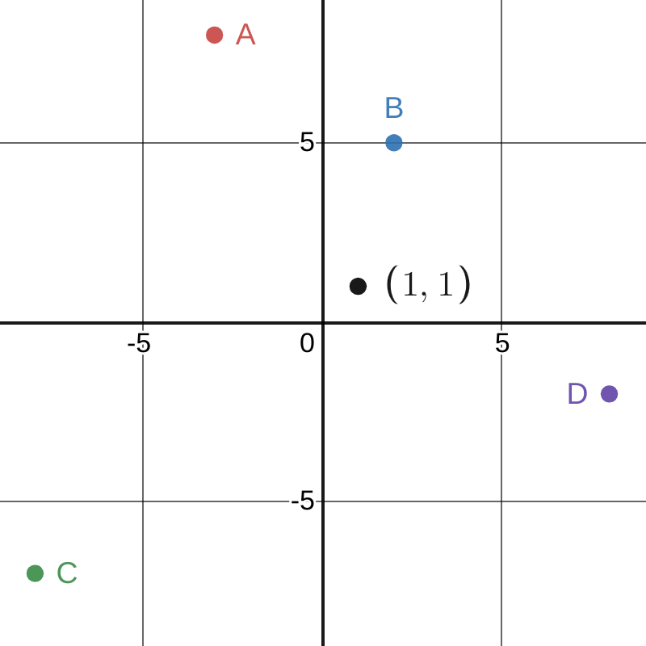
NAME:
The black point below has coordinates (1, 1).
Choose TWO points.
What could their coordinates be?

Slide 6



NAME:
Determine the value of each expression.
Choose an expression. Use a model to show why your answer makes sense.
Explain the model.

Slide 7





NAME:
Choose THREE problems below.
What are the products?
You multiply two integers and the product (or answer) is (–36)
List two possible pairs of integers:
Choose a pair of numbers. Use a model to show why your answer makes sense.
Explain the model.

Slide 8




NAME:
Choose THREE problems below.
What are the quotients?
You divide two integers and the quotient (or answer) is –12.
List two possible pairs of integers.
Choose a pair of numbers. Use a model to show why your answer makes sense.
Explain the model.

Slide 9
Look Fors
Prior to Grade 8 Expectation / Grade 8 Expectation / MTH1W Expectation
 | Understanding Integers |  |  | Addition and Subtraction of Integers |  |  | Multiplication and Division of Integers |  |  |  |  |  | Order of Operations with Integers
 | identify and compare integers | represent and order integers, using a variety of tools (e.g., two colour counters, virtual manipulatives, number lines) | apply an understanding of integers to describe location, direction, amount, and changes in any of these, in various contexts | visually represent adding and subtracting integers (e.g., two colour counters, virtual manipulatives, number lines) | add and subtract integers symbolically (-3) + 5 and (-3) - 5 | can predict the sign and the size of the answer when adding and subtracting integers | visually represent the multiplication of integers | multiply integers symbolically (-3) x 5 | visually represent the division of integers | divide integers symbolically (-6) ÷ 2 | can predict the sign and size of the answer when multiplying and dividing integers | multiply and divide integers without the use of tools (e.g.: calculator) | can flexibly apply order of operations when dealing with integers
Slide | 4 | 4 | 5 | 6 | 6 |  | 7 | 7 | 8 | 8

Slide 10
FOLLOW-UP TEACHING STRATEGIES
Instruction that follows the diagnostic task should be responsive to observations made about students’ current understanding on the continuum. The following are possible teaching strategies you might use to help students develop their understanding.
A word of caution: avoid telling students “rules” to use. Instead, work with students to develop understanding first based on visual representations.
Suggested Instructional Strategies for Teaching Integers (WRDSB - Grade 7-8) Small Group Instruction - work with small groups of 2, 4, 6 students (so they can be working in pairs) at a time to move them forward along the continuum (the rest of the class can be working on purposeful practice or tasks associated with the theme/project in progress) Anchor Charts (see examples below) - co-construct anchor charts as a class once understanding about certain operations has been achieved Math Talks - facilitate discussions with whole class or small group about various math concepts, using a problem or series of problems to prompt discussion Problem Strings - these are a sequence of carefully designed problems used to promote discussion with students about a mathematical concept and support students’ learning by offering helpful models for developing conceptual understanding as well as mental fluency (see Additional Resources)

Slide 11
MATERIALS / MANIPULATIVES
Students who struggle with understanding operations with integers will benefit greatly from using visual representations and concrete materials to represent quantities and operations.
Here are some materials / manipulatives that might be beneficial in supporting this development:
Concrete or digital two sided counters Concrete or digital numberline Different Coloured Dice (Purposeful Practice Example: Use dice with Open Middle Problems; different colours can be negative or positive.)

Slide 12


ADDITIONAL RESOURCES
These resources provide some sample problems and planning tools that can be used with students to develop their understanding.
Students will benefit from purposeful activities as well as opportunities to discuss and compare their thinking. Practices that encourage students to think - rather than mimic - should be emphasized when using these or any resources.
EDUGAINS: Gap Closing - Integers (Facilitator’s Guide) EDUGAINS: Gap Closing - Integers (Student Workbook) (note: not to be used as worksheets but as discussion prompts / opportunities to deepen understanding / planning for small group instruction) Building Powerful Numeracy for Middle + High School Students by Pamela Weber Harris (each Math Dept has a copy; problem strings to support building conceptual understanding of integers) LEAPS and BOUNDS (consult Math Dept / Spec Ed for hard copy) (note: these go to grade 8, so may be useful for some students) *Background knowledge about the progression of students’ understanding of number in early grades: Graham Fletcher Progression Videos

Slide 13
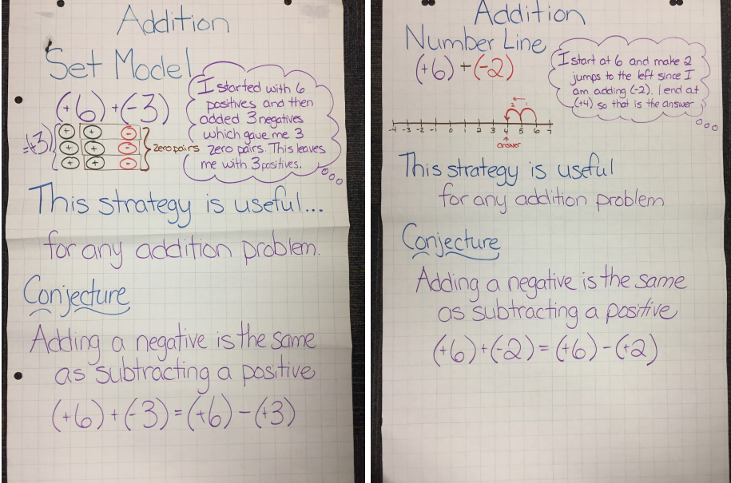
Notes:
Examples of anchor charts that could be co-constructed as a class once understanding about certain operations has been achieved.
From WRDSB elementary classrooms, PD provided by Rhonda Hewer (Learning Services Consultant)

Slide 14
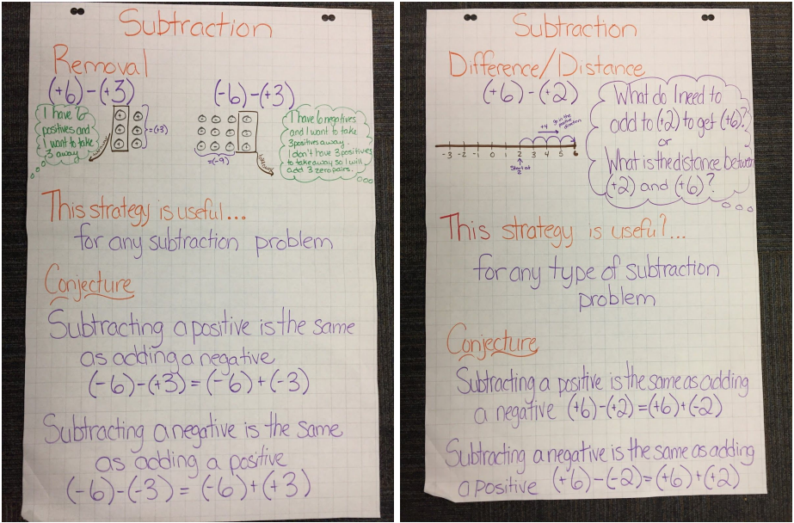
Notes:
Examples of anchor charts that could be co-constructed as a class once understanding about certain operations has been achieved.
From WRDSB elementary classrooms, PD provided by Rhonda Hewer (Learning Services Consultant)

Slide 15
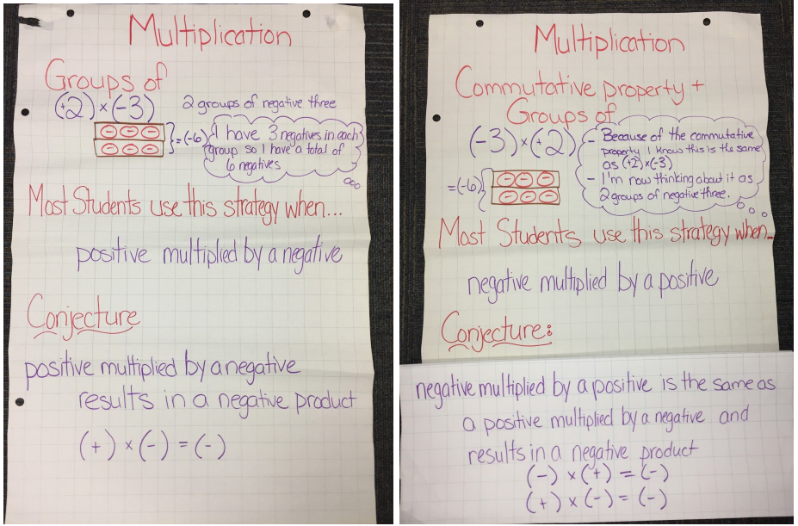
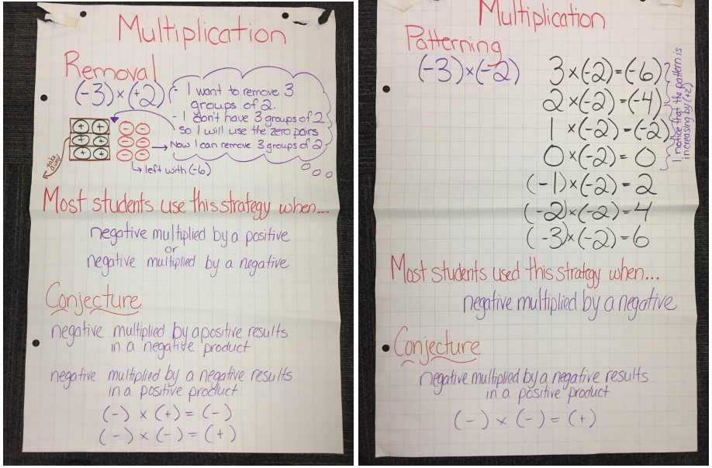
Notes:
Examples of anchor charts that could be co-constructed as a class once understanding about certain operations has been achieved.
From WRDSB elementary classrooms, PD provided by Rhonda Hewer (Learning Services Consultant)

Slide 16
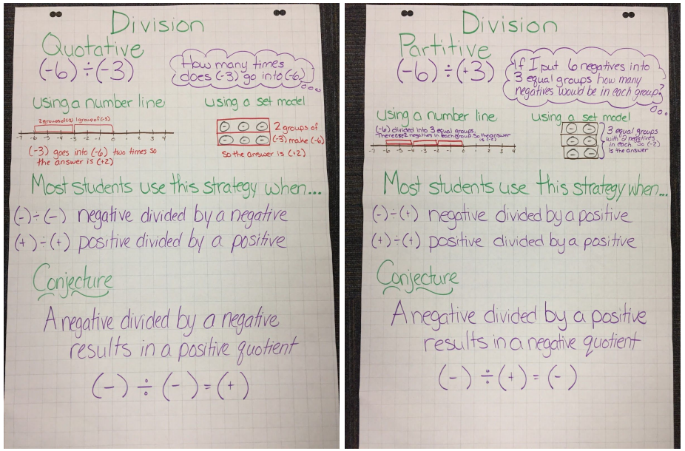
Notes:
Examples of anchor charts that could be co-constructed as a class once understanding about certain operations has been achieved.
From WRDSB elementary classrooms, PD provided by Rhonda Hewer (Learning Services Consultant)

Slide 17
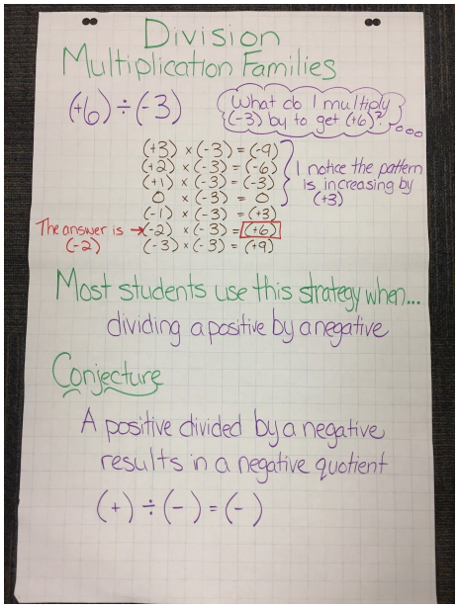
Notes:
Examples of anchor charts that could be co-constructed as a class once understanding about certain operations has been achieved.
From WRDSB elementary classrooms, PD provided by Rhonda Hewer (Learning Services Consultant)

