Slide 1
MTH1W
Diagnostic Thinking Task
Rational Numbers

Slide 2
Teacher Notes
FACILITATING THE DIAGNOSTIC:
Slides with a grey background should not be shown to students.
The purpose of this diagnostic is to learn more about what students recall and what their comfort level is with various concepts. This is NOT a test.
It is HIGHLY recommended that this tool be used in the following ways:
Provide 1-3 problems to students at a time for a short part of the period
Emphasize that you want to learn about what they remember - this is NOT a reflection on them
Emphasize that you want to learn how they think, so the visuals and explanations they give for their thinking will be really helpful to you
Paper Approach: Provide each student with a paper copy of the selected questions (e.g., slides 3-4 on the first day and slides 5 and 6 on the next). Provide concrete materials (if available) in case students choose to use these to represent their thinking (e.g., Fraction Strips, Grid paper).
Digital Approach: Provide students with a copy of the slides (only the problem slides) via Google Classroom or your VLE. Have students show their thinking digitally or by inserting pictures onto the slides. They may choose to use Fraction Bars in Polypad.
For either approach, circulate / give students the explicit option of verbally explaining/showing their thinking to you instead of recording it on paper. Avoid confusion based on running the technology. Sometimes paper / writing by hand on a whiteboard can give you more information than trying to figure out how to do something with the technology. Make notes about observations to use for future record-keeping.
ASSESSING THE DIAGNOSTIC:
Observe where students have difficulty and make notes on the MTH1W Developmental Continuum (Rationals tab) for each student. Use the look fors to help guide your observations. These notes will help you identify what you can reteach to close gaps in skills and concepts, differentiate instruction as needed, and provide intervention.
FOLLOW-UP STRATEGIES AND RESOURCES
Suggestions for how to differentiate instruction, close gaps and skills and provide intervention are provided here.

Slide 3
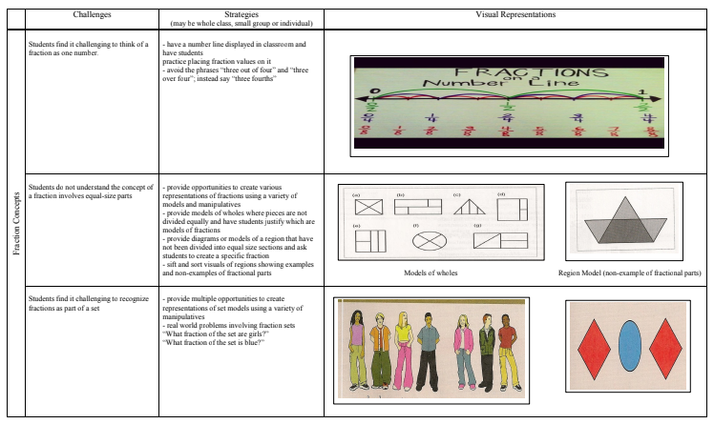
SOME BACKGROUND:
WHY MIGHT STUDENTS STRUGGLE WITH FRACTIONS
Visit this document for more information about what students might struggle with and some strategies to address these misconceptions:

Slide 4




Label the line with each number below. Or drag the number if doing this digitally.
NAME:
Choose two numbers. How did you figure out where they should go?
The two numbers I chose are:
I figured out where they should go by…

Slide 5



Will the answers to these problems be closer to 0, ½ or 1?
Show your thinking with visuals that makes sense to you.
NAME:

Slide 6



NAME:
Estimate to decide if the product will be closer to ½ or 1. Circle your choice.
Draw pictures or show your thinking to justify your choices.
Closer to ½ | Closer to 1
Closer to ½ | Closer to 1
Describe a situation where you might multiply

Slide 7



NAME:
Estimate to decide if the quotient will be closer to ½, 1 or 2. Circle your choice.
Draw pictures or show your thinking to justify your choices.
Closer to ½ | Closer to 1 | Closer to 2
Closer to ½ | Closer to 1 | Closer to 2
Describe a situation where you might divide

Slide 8
Look Fors (Part 1)
Prior to Grade 8 Expectation / Grade 8 Expectation / MTH1W Expectation
 | Working with the Real Number System |  | Addition and Subtraction With Fractions |  |  |  |  |  | Simplifying Fractions
 | compare and order positive numbers in the real number system (rational and irrational) | compare and order positive and negative numbers in the real number system (rational and irrational) | visually represent fraction addition and subtraction situations | add and subtract fractions with different denominators symbolically (3/5 + 2/3 = 19/15) or (2/3 - 3/5 = 1/15) | given a model, write the associated addition/subtraction or multiplication/division computation | estimate the sum/difference when adding/subtracting fractions | estimate the sum/difference when adding/subtracting positive and negative numbers (rationals) | add and subtract positive and negative numbers (rationals) | simplify fractions to demonstrate understanding of equivalence and for various purposes (e.g., operations with fractions)
Slide | 4 |  | 5 | 5 |  | 5

Slide 9
Look Fors (Part 2)
Prior to Grade 8 Expectation / Grade 8 Expectation / MTH1W Expectation
 | Multiplication With Fractions |  |  |  |  |  | Division With Fractions |  |  |  |  |  | Order of Operations
 | visually represent multiplying a fraction by a fraction using a model (area/array model, fraction strips, number line) | multiply fractions symbolically (3/5 x 2/3 = 6/15) | visually represent multiplication questions involving fractions and mixed numbers using a model (area/array model, fraction strips, number line) | solve multiplication questions involving fractions and mixed numbers symbolically (2 3/5 x 2/3 = 26/15) | estimate the product when multiplying fractions | solve multiplication questions involving positive and negative fractions and mixed numbers symbolically, building up to simplifying fractions first before multiplying | visually represent dividing a fraction by a fraction using a model (area/array model, fraction strips, number line) | divide fractions symbolically (3/5 ÷ 2/3 = 9/10) | visually represent division questions involving fractions and mixed numbers using a model (area/array model, fraction strips, number line) | solve division questions involving fractions and mixed numbers symbolically (2 3/6 ÷ 2/3 = 45/12 = 15/4) | estimate the quotient when dividing fractions | solve division questions involving positive and negative fractions and mixed numbers symbolically, using a range of strategies (multiplying by the reciprocal, finding a common denominator, simplifying before dividing, etc.) | use the properties and order of operations, and the relationships between operations, to solve problems involving positive and negative fractions and decimal numbers
Slide | 6 | 6 |  | 6 | 6 |  | 7 | 7 |  | 7 | 7

Slide 10
FOLLOW-UP TEACHING STRATEGIES
Instruction that follows the diagnostic task should be responsive to observations made about students’ current understanding on the continuum. The following are possible teaching strategies you might use to help students develop their understanding.
A word of caution: avoid telling students “rules” to use. Instead, work with students to develop understanding first based on visual representations.
Suggested Instructional Strategies for Teaching Integers (WRDSB - Grade 7-8) Small Group Instruction - work with small groups of 2, 4, 6 students (so they can be working in pairs) at a time to move them forward along the continuum (the rest of the class can be working on purposeful practice or tasks associated with the theme/project in progress) Anchor Charts - co-construct anchor charts as a class once understanding about certain operations has been achieved Math Talks - facilitate discussions with whole class or small group about various math concepts, using a problem or series of problems to prompt discussion Problem Strings - these are a sequence of carefully designed problems used to promote discussion with students about a mathematical concept and support students’ learning by offering helpful models for developing conceptual understanding as well as mental fluency (see Additional Resources)

Slide 11
MATERIALS / MANIPULATIVES / MODELS
Students who struggle with understanding operations with integers will benefit greatly from using visual representations and concrete materials to represent quantities and operations.
Here are some materials / manipulatives that might be beneficial in supporting this development:
Number Lines and Open Number Lines (e.g., digital number line) Fraction Strips Grid Paper Polypad: Fraction Bars - these can be used to model equivalent numbers and operations between numbers (follow this link for examples and tutorials) *Avoid circular models of fractions as they are often represented inaccurately

Slide 12

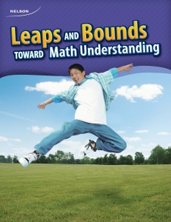
ADDITIONAL RESOURCES
These resources provide some sample problems and planning tools that can be used with students to develop their understanding.
Students will benefit from purposeful activities as well as opportunities to discuss and compare their thinking. Practices that encourage students to think - rather than mimic - should be emphasized when using these or any resources.
EDUGAINS: Gap Closing - Fractions (Facilitator’s Guide) EDUGAINS: Gap Closing - Fractions (Student Workbook) (note: not to be used as worksheets but as discussion prompts / opportunities to deepen understanding / planning for small group instruction) EDUGAINS: Gap Closing - Decimals (Facilitator’s Guide) EDUGAINS: Gap Closing - Decimals (Student Workbook) (note: not to be used as worksheets but as discussion prompts / opportunities to deepen understanding / planning for small group instruction) Building Powerful Numeracy for Middle + High School Students by Pamela Weber Harris (each Math Dept has a copy; problem strings to support building conceptual understanding of fractions and decimals) LEAPS and BOUNDS (consult Math Dept / Spec Ed for hard copy) (note: these go to grade 8, so may be useful for some students)

