Slide 1
MTH1W
Diagnostic Thinking Task
Algebra

Slide 2
Teacher Notes
FACILITATING THE DIAGNOSTIC:
Slides with a grey background should not be shown to students.
The purpose of this diagnostic is to learn more about what students recall and what their comfort level is with various concepts. This is NOT a test.
It is HIGHLY recommended that this tool be used in the following ways:
Provide 1-3 problems to students at a time for a short part of the period
Emphasize that you want to learn about what they remember - this is NOT a reflection on them
Emphasize that you want to learn how they think, so the visuals and explanations they give for their thinking will be really helpful to you
Paper Approach: Provide each student with a paper copy of the selected questions (e.g., slides 3-4 on the first day and slides 5 and 6 on the next). Make physical algebra tiles available to students.
Digital Approach: Provide students with a copy of the slides (only the problem slides) via Google Classroom or your VLE. Have students show their thinking digitally or by inserting pictures onto the slides. If necessary, describe how to use the algebra tiles: You can duplicate (CTRL D or CMD D) relevant tiles and move them around the slide.
For either approach, circulate / give students the explicit option of verbally explaining/showing their thinking to you instead of recording it on paper. Avoid confusion based on running the technology. Sometimes paper / writing by hand on a whiteboard can give you more information than trying to figure out how to do something with the technology. Make notes about observations to use for future record-keeping.
ASSESSING THE DIAGNOSTIC:
Observe where students have difficulty and make notes on the MTH1W Developmental Continuum (Algebra tab) for each student. Use the look fors to help guide your observations. These notes will help you identify what you can reteach to close gaps in skills and concepts, differentiate instruction as needed, and provide intervention.
FOLLOW-UP STRATEGIES AND RESOURCES
Suggestions for how to differentiate instruction, close gaps and skills and provide intervention are provided here.

Slide 3

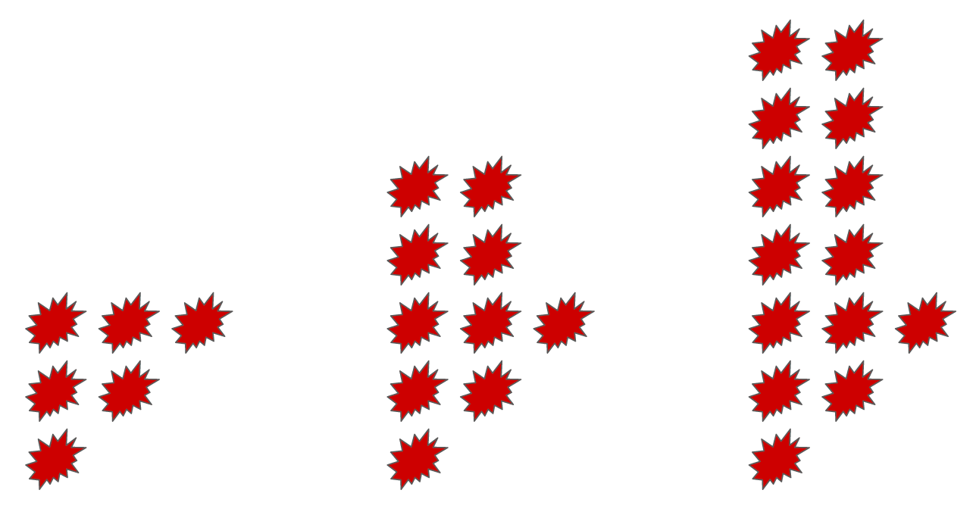
Here are figures 1, 2 and 3 of a visual pattern. What would figures 0, 4 and 5 look like?
Create pattern rule to represent the number of “splats” in any figure.
NAME:
Figure 0
Figure 4 | Figure 5

Slide 4
Choose TWO problems. Find the value of the expressions:
Without substituting values, explain or show why this statement has to be true:
NAME:
20 - 3p, if p = 7
4k - 3 + k, if k = -3
6 + m + 2m², if m = 3

Slide 5




Choose TWO expressions. Write the simplest form:
Explain why someone might say that this set of algebra tiles could be modelled with these two expressions?
NAME:
2a + 4 + 5a + 8
–2h + (–7) + 3h – 8
9t + (–5) + (–8s) + 10

Slide 6

Write an equation to model each situation, then solve it.
NAME:
Use algebra tiles in Polypad if necessary. Insert a screenshot here or describe your thinking verbally to your teacher.
k
k
1
1
1
1
1
1
-1
-1
1
1
k
k
1
1
1
1
x
-1
-1
1
1
1
1
1
1
-1
-1
1
1
If 4p + 12 = 20, what values make sense to complete these statements. Explain one.
4p + 8 = ____
8p + 24 = ____

Slide 7
Look Fors (Part 1)
Prior to Grade 8 Expectation / Grade 8 Expectation / MTH1W Expectation
 | Understanding Variables |  |  | Evaluating Expressions
 | recognize that a variable is a letter that represents a quantity | use equations with one or more variables to describe real-life situations | Create an expression or equation to represent a situation that includes one or more variable. | evaluate algebraic expressions that involve whole numbers | evaluate algebraic expressions that involve decimals | evaluate algebraic expressions that involve rational numbers | compare two or more algebraic expressions using numerical methods (i.e., substitution) to identify those that are equivalent and justify their choices
Slide | 3 | 3 | 3 | 4 | 4

Slide 8
Look Fors (Part 2)
Prior to Grade 8 Expectation / Grade 8 Expectation / MTH1W Expectation
 | Simplifying and Expanding Algebraic Expressions
 | use tools to add and subtract monomials with a degree of 1 that involve whole numbers | Use tools to add and subtract monomials with a degree of 1 that involve integers (start with positive whole numbers first) | Use tools to add binomials with a degree of 1 that involve integers (start with positive whole numbers first) | Simplify algebraic expressions (with degree greater than 1) using various representations and tools | Use tools to apply the distributive property with a numerical multiplier | Use tools to multiply monomials by applying an understanding of multiplying powers with the same base | Use tools to apply the distributive property with a monomial multiplier | Expand and simplify algebraic expressions with a numerical multiplier and a monomial multiplier (distributive property)
Slide | 5 | 5 | 5

Slide 9
Look Fors (Part 3)
Prior to Grade 8 Expectation / Grade 8 Expectation / MTH1W Expectation
 | Solving Equations
 | Make reasonable guesses if they guess and test to solve an equation. | represent solving an equation using pan balances and/or algebra tiles and/or bar models or a double number line | solve equations that involve multiple terms and whole numbers and verify the solution | solve equations that involve multiple terms and decimal numbers and verify the solution | solve equations that involve whole numbers and decimals in various contexts and verify the solution | Describe what the solution to a linear equation might represent in a real-life context. | Solve one-step equations that involve whole numbers and decimals in various contexts algebraically and verify the solution. | Solve two-step equations algebraically that involve whole numbers and decimals in various contexts and verify the solution, | Solve multi-step equations algebraically that involve whole numbers and decimals in various contexts algebraically and verify the solution | Solve equations involving fractional coefficients in various contexts and verify the solution | Verify the solution to an equation using different strategies (substitution or graphing).
Slide |  | 6 | 6

Slide 10
FOLLOW-UP TEACHING STRATEGIES
Instruction that follows the diagnostic task should be responsive to observations made about students’ current understanding on the continuum. The following are possible teaching strategies you might use to help students develop their understanding.
A word of caution: avoid telling students “rules” to use. Instead, work with students to develop understanding first based on visual representations and connections between representations.
Small Group Instruction - work with small groups of 2, 4, 6 students (so they can be working in pairs) at a time to move them forward along the continuum (the rest of the class can be working on purposeful practice or tasks associated with the theme/project in progress) Visual and Concrete Models - work with students to build conceptual understanding through the use of visual and concrete models (see Materials / Manipulatives) Problem Strings - these are a sequence of carefully designed problems used to promote discussion with students about a mathematical concept and support students’ learning by offering helpful models for developing conceptual understanding as well as mental fluency (see Additional Resources)

Slide 11
MATERIALS / MANIPULATIVES / MODELS
Students who struggle with understanding operations with integers will benefit greatly from using visual representations and concrete materials to represent quantities and operations.
Here are some materials / manipulatives that might be beneficial in supporting this development:
Physical Algebra Tiles - these can be used to manipulate and simplify algebraic expressions as well as model solving equations Polypad: Balance Scales - these can be used to model solving equations, where the scale tips when the equation is not balanced (follow this link for examples and tutorials) Virtual Algebra Tiles - here is another virtual algebra tile source Double Number Line - this is a model for solving equations that illustrates equivalence and translates well to dealing with negative coefficients for variables and solutions that are negative (consider purchasing Algebra Problem Strings as a department to learn more about this model)

Slide 12

ADDITIONAL RESOURCES
These resources provide some sample problems and planning tools that can be used with students to develop their understanding.
Students will benefit from purposeful activities as well as opportunities to discuss and compare their thinking. Practices that encourage students to think - rather than mimic - should be emphasized when using these or any resources.
EDUGAINS: Gap Closing - Algebra (Facilitator’s Guide) EDUGAINS: Gap Closing - Algebra (Student Workbook) (note: not to be used as worksheets but as discussion prompts / opportunities to deepen understanding / planning for small group instruction) EDUGAINS: Gap Closing - Solving Equations (Facilitator’s Guide) EDUGAINS: Gap Closing - Solving Equations (Student Workbook) (note: not to be used as worksheets but as discussion prompts / opportunities to deepen understanding / planning for small group instruction) LEAPS and BOUNDS (consult Math Dept / Spec Ed for hard copy) (note: these go to grade 8, so may be useful for some students) Algebra Problem Strings (consult Math Dept to purchase a hard copy if dept does not already have one; provides sample problem strings for using double number like with solving equations and supports for facilitating conversations about algebraic concepts)

