Slide 1

Intro to Python Coding
Olivia Lu
Doug McDougall

Slide 2
Python
Python is a high-level, general-purpose programing language.

Slide 3
What is Colab?
Colab or "Colaboratory", allows writing and executing Python in the browser
Easy to use for students, data scientists & researchers
  Login Google
  Colaboratory: https://colab.research.google.com/
Notes:
Email: oisegrade9math@gmail.com
Password: Grade9Research
Introduction to Colab: https://www.youtube.com/watch?v=inN8seMm7UI

Slide 4

String Constant
Let’s print a message:

Slide 5
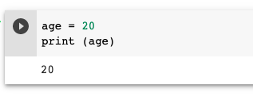
Variables
Variables are used to temporary store data in the computer memory

Slide 6
Variables Types
Numeric
age= 20
Decimals
price = 19.95
Alpha Numeric or String
firstName = “Sofia”
Boolean (true or false)
isATeacher = True

Slide 7
Exercise (together)
Define variables for a hospital program to store the following information:
We check in a patient named John Smith
He is 30 years old
He is a new patient

Slide 8
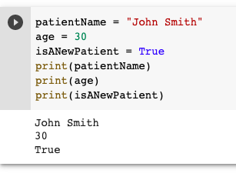
Exercise
Let’s print the variables’ values
Notes:
patientName = “John Smith”
age = 30
isANewPatient = True
Print (patientName)
Print (age)
Print (isANewPatient)

Slide 9
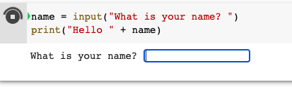
Input from User
input is used to request data to the user
The data entered by the user is stored in a variable (name)
+ is used to concatenate a constant (“Hello “) with the variable
>> Press enter

Slide 10
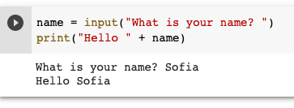
Printing input data

Slide 11
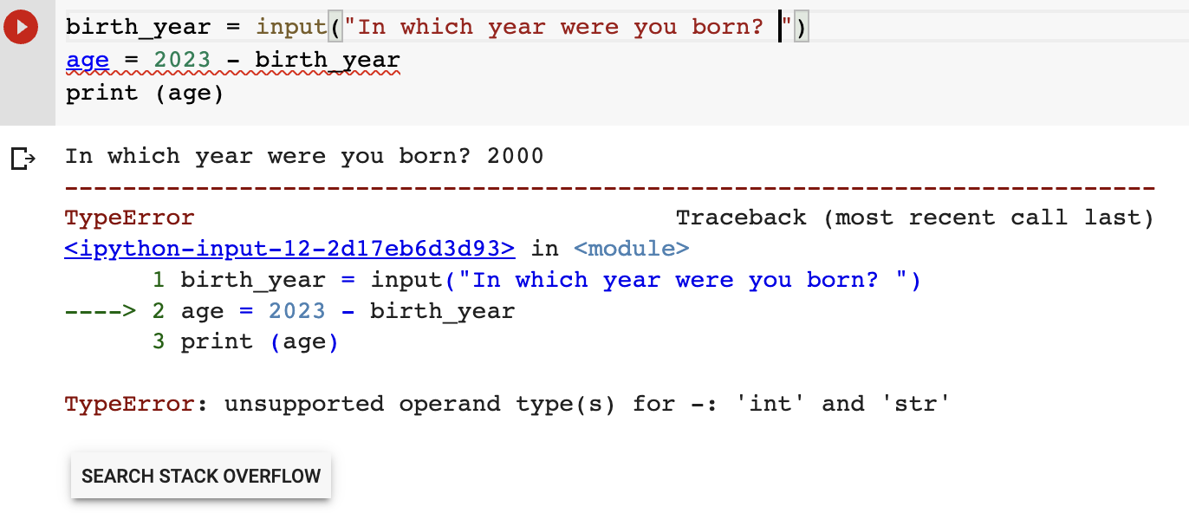
Converting data types
Input data is a string (birth_year)
Only numeric data can be used to do calculations

Slide 12
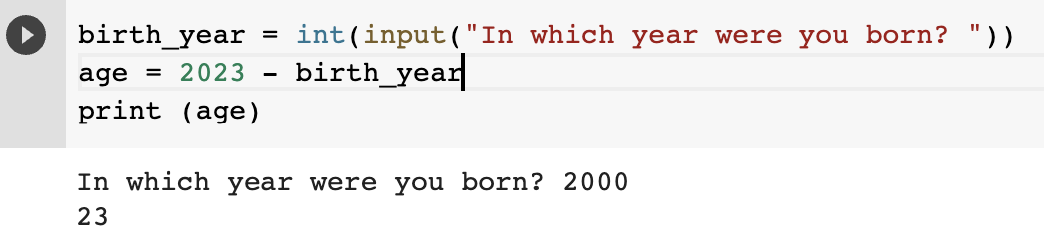
Converting string to integer
int (variable) converts a string variable to an integer

Slide 13
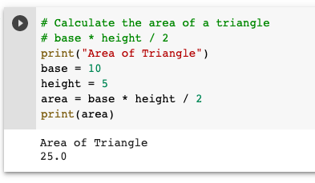
Calculations
Let’s calculate the area of the triangle with base = 10 cm & height = 5 cm

Slide 14
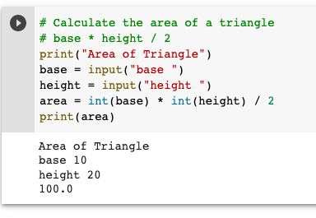
Calculator
Let’s ask the user the length of the base and the height

Slide 15
Conditions
Let’s compare the Age of 2 students and decide who is the older one
Student 1: Name & Age
Student 2: Name & Age
Age1 vs Age2
>
<
=
Student 1 is older than Student 2
Student 2 is the same age as Student 1
Student 2 is older than Student 1

Slide 16
Who is older?
# Who is older?
print ("Student 1")
name1 = input ("What is your name? ")
age1 = input ("How old are you? ")
print ("Student 2")
name2 = input ("What is your name? ")
age2 = input ("How old are you? ")
if int(age1) > int(age2):
print(name1 + " is older than " + name2)
elif int(age1) == int(age2):
print(name1 + " is the same age as " + name2)
else:
print(name2 + " is older than " + name1)
Ask Student 1’s age
Ask Student 2’s age
Compare the age and print the result

Slide 17
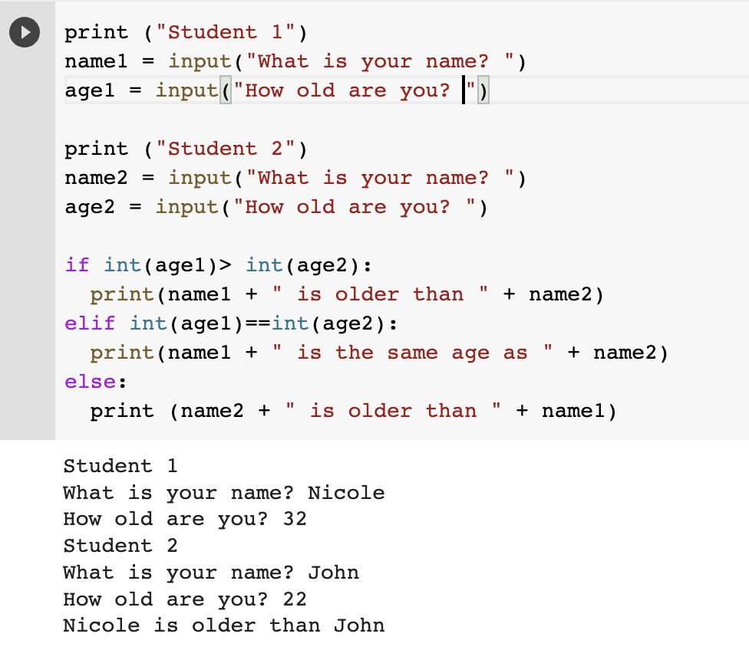
Who is older?

Slide 18
Exercises
Convert Temperature
Convert Distance
Convert Length
Convert Weight

Slide 19
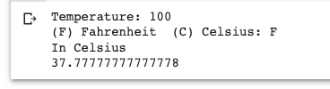

Exercise – Group 1
Convert Temperature
From Fahrenheit to Celsius and vice versa depending on the user’s input
Formulas:
F = (C *9 / 5) + 32
C = (F - 32) * 5 / 9

Slide 20
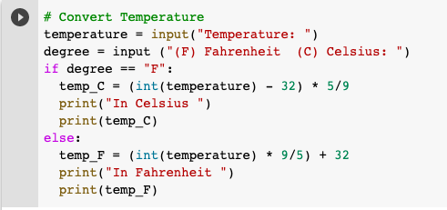
Exercise – Group 1
Notes:
# Convert Temperature
temperature = input ("Temperture: ")
degree = input ("(F) Fahrenheit (C) Celsius")
if degree == "F":
temp_C = (int(temperature) - 32) * 5/9
print ("In Celsius")
print (temp_C)
else:
temp_F = (int(temperature) * 9/5) + 32
print ("In Fahrenheit")
print (temp_F)

Slide 21


Exercise – Group 2
Convert Distance
From Km to Miles and vice versa depending on the user’s input
Formulas:
M = K / 1.609
K = M * 1.609

Slide 22
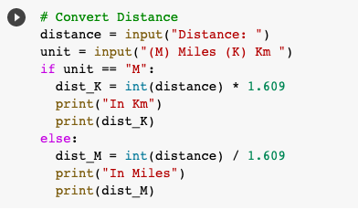
Exercise – Group 2
Notes:
# Convert Distance
distance = input ("Distance: ")
unit = input ("(M) Miles (K) Km")
if unit == "M":
dist_K = int(distance) * 1.609
print ("In Km")
print (dist_K)
else:
dist_M = int(distance) / 1.609
print ("In Miles")
print (dist_M)

Slide 23

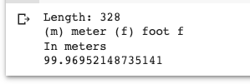
Exercise – Group 3
Convert Length
From Meter to feet and vice versa depending on the user’s input
Formulas:
m = ft / 3.281
ft = m * 3.281

Slide 24
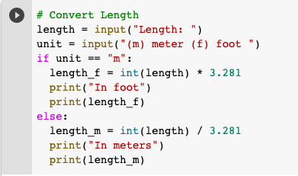
Exercise – Group 3
Notes:
# Convert Length
length = input ("Length: ")
unit = input ("(m) meter (f) foot")
if unit == "m":
length_f = int(length) * 3.281
print ("In feet")
print (length_f)
else:
length_m = int(length) / 3.281
print ("In meters")
print (length_m)

Slide 25

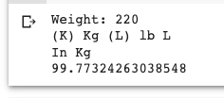
Exercise – Group 4
Convert Weight
From Kg to Pounds and vice versa depending on the user’s input
Formulas:
kg = lb / 2.205
lb = kg * 2.205

Slide 26
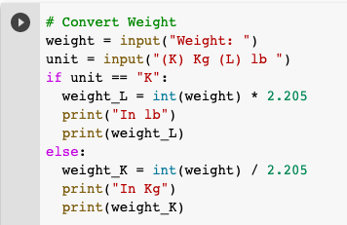
Exercise – Group 4
Notes:
# Convert Weight
weight = input ("Weight: ")
unit = input ("(K) Kg (L) lb")
if unit == "K":
weight_lb = int(weight) * 2.205
print ("In lb")
print (weight_lb)
else:
weight_kg = int(weight) / 2.205
print ("In kg")
print (weight_kg)

Slide 27
Number Patterns
Stage Number (N) | Even Number
1 | 2
2 | 4
3 | 6
4 | 8
5 | 10
Even Number = 2 * N

Slide 28
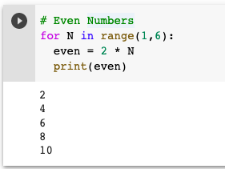
For loop
N = 1
N < 6
no
yes
even = 2 * N
Print even
N = N + 1
end

Slide 29
Sum Patterns
Stage Number (N) | Even Number | Sum
1 | 2 | 2
2 | 4 | 6
3 | 6 | 12
4 | 8 | 20
5 | 10 | 30
even = 2 * N
Sum = Sum + even

Slide 30
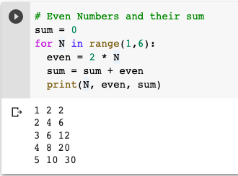
Sum Patterns

Slide 31
List
The lists are used to store an array of elements
nList
1
2
3
4
5
evenList
2
4
6
8
10
# To define a list
nList = [] evenList = []
# To store the numbers in the list
nList.append(n) evenList.append(even)

Slide 32
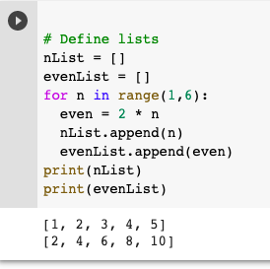
List

Slide 33
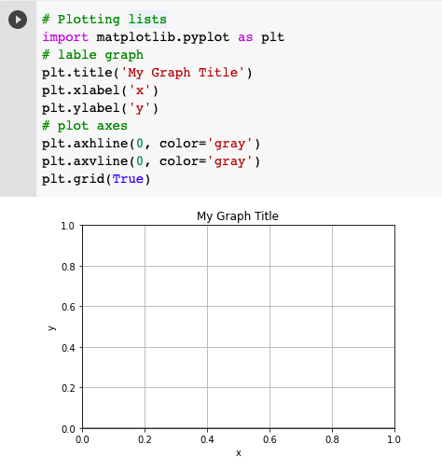
Graph
title
grid
ylabel
xlabel
Library to graph: matplotlib.pyplot

Slide 34
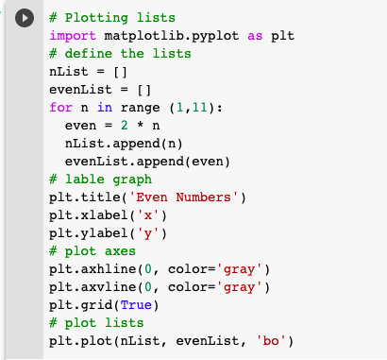
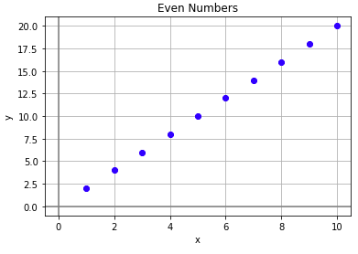
Plotting a list

Slide 35
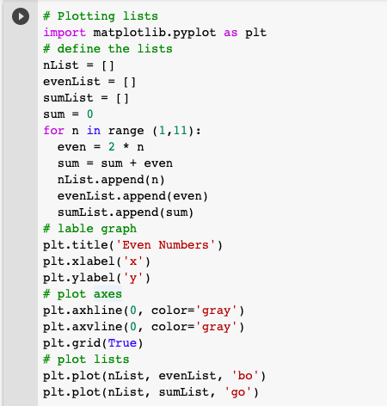
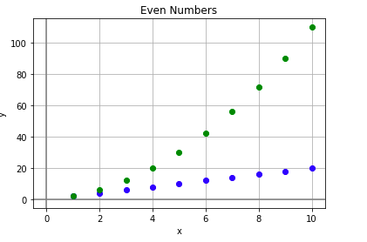
Plotting even number & their sum

Slide 36
Linear Relationships
X | Y1 = 2 X + 5 | Y2 = -3 X + 1
-5 | -5 | 16
-4 | -3 | 13
-3 | -1 | 10
-2 | 1 | 7
-1 | 3 | 4
-0.8 | 3.4 | 3.4
0 | 5 | 1
1 | 7 | -2
2 | 9 | -5
3 | 11 | -8
4 | 13 | -11
5 | 15 | -14
Y1 = m1 * X + b1
Y2 = m2 * X + b2
Y1 = 2 X + 5
Y2 = -3 X + 1
Intersection point
2 X + 5 = -3 X + 1
5 X = -4
X = -0.8
(X,Y) = (-0.8, 3.4)

Slide 37
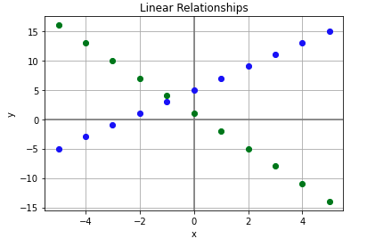
Plotting Linear Relationships

Slide 38
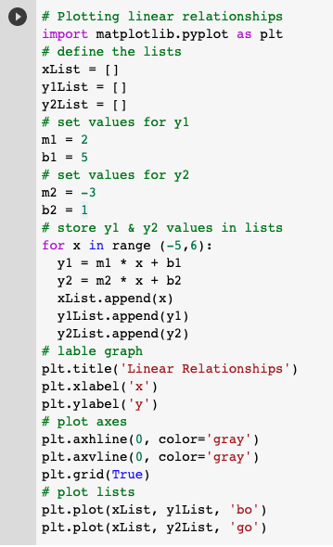
Plotting Linear Relationships

