Slide 1

Intro to Scratch Coding
Olivia Lu
Doug McDougall

Slide 2
Scratch Editor
  https://scratch.mit.edu/projects/editor
Notes:
https://scratch.mit.edu/projects/editor

Slide 3

Sprite

Slide 4
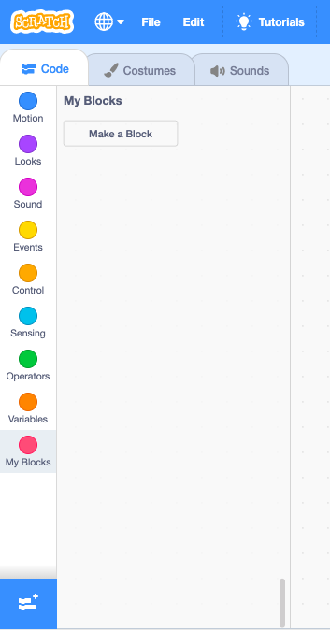
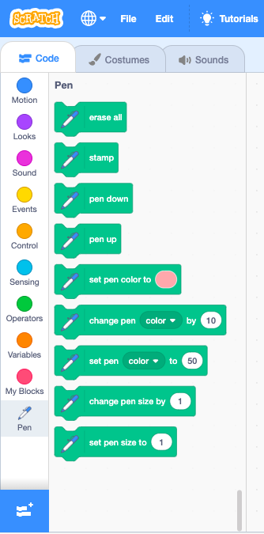
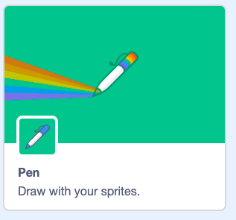
Add Pen

Slide 5
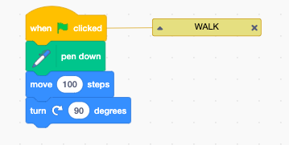
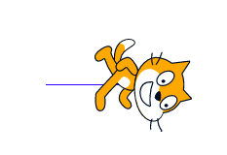
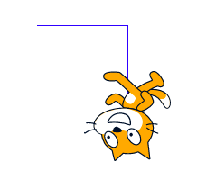
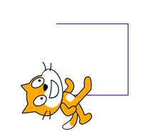
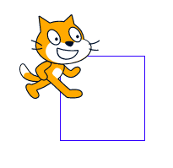
Walk
Let’s make the sprite walk and turn 90 degrees
Play it walk again, again and again

Slide 6
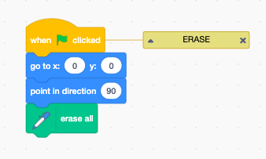

Erase

Slide 7
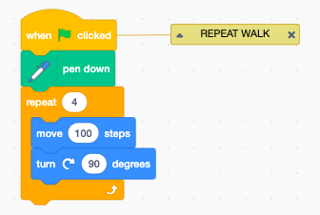
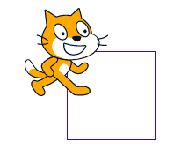
Repeat

Slide 8
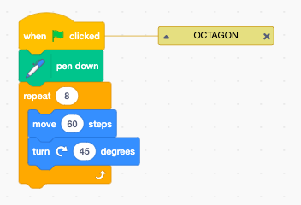
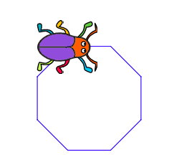
Exercise
Draw an Octagon

Slide 9
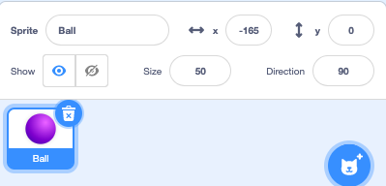

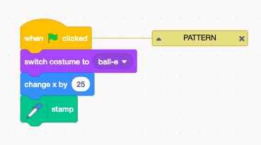
Repeating Patterns

Slide 10
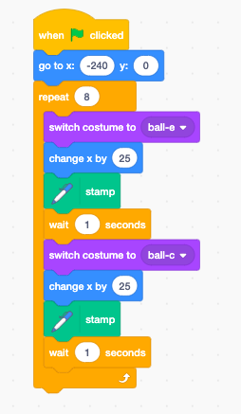

Repeating Patterns

Slide 11
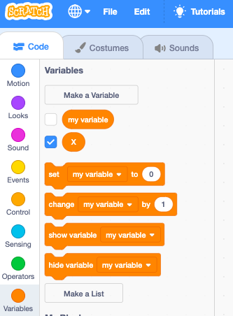
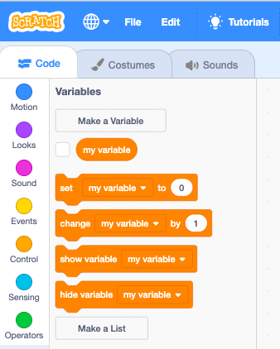
Make a Variable

Slide 12
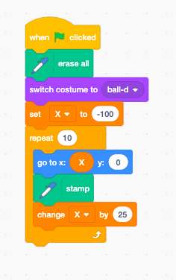

Variables (X)

Slide 13
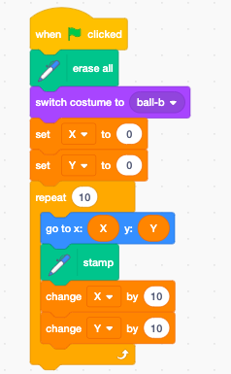

Variables (X & Y)

Slide 14
Math application
Linear equation
  Y = m * X + b

Slide 15
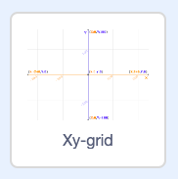
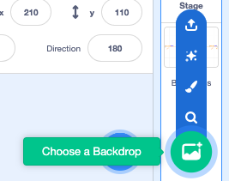
Background

Slide 16
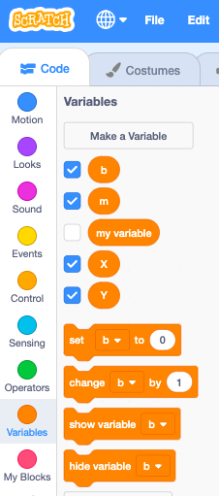

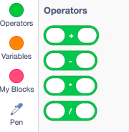
Operations
  Y = m * X + b

Slide 17
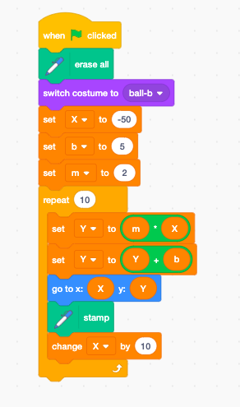
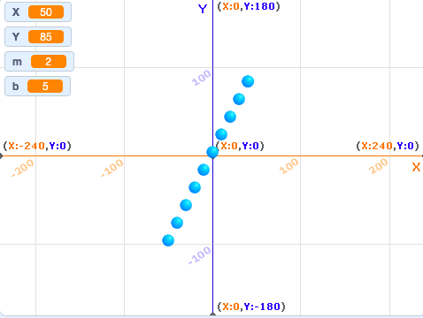
Y = 2 X + 5

Slide 18
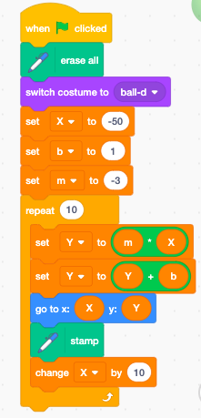
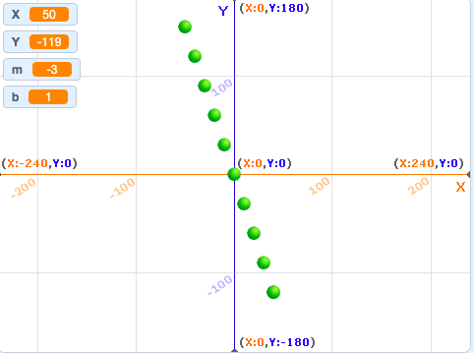
Y = -3 X + 1

Slide 19
Linear Relationships
X | Y1 = 2 X + 5 | Y2 = -3 X + 1
-5 | -5 | 16
-4 | -3 | 13
-3 | -1 | 10
-2 | 1 | 7
-1 | 3 | 4
-0.8 | 3.4 | 3.4
0 | 5 | 1
1 | 7 | -2
2 | 9 | -5
3 | 11 | -8
4 | 13 | -11
5 | 15 | -14
Y1 = m1 * X + b1
Y2 = m2 * X + b2
Y1 = 2 X + 5
Y2 = -3 X + 1
Intersection point
2 X + 5 = -3 X + 1
5 X = -4
X = -0.8
(X,Y) = (-0.8, 3.4)

Slide 20
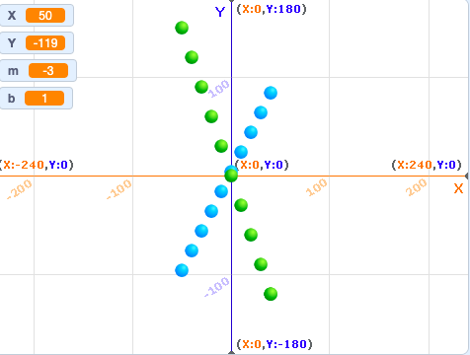
Plotting Linear Relationships

Slide 21
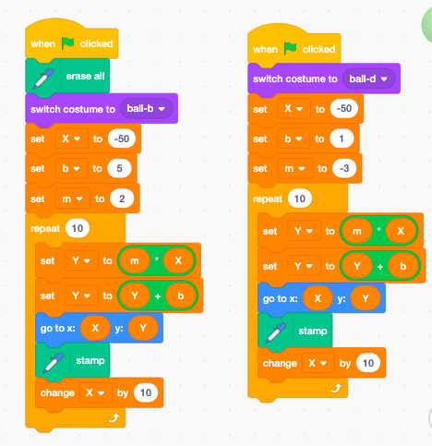
Linear Relationships
Y = 2 X + 5
Y = -3 X + 1

