Slide 1
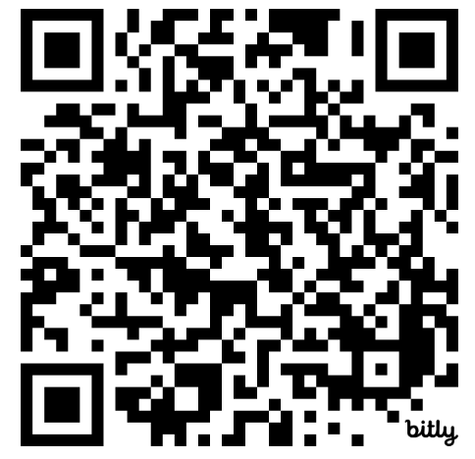

Grade 9 Mathematics Research Project
TDSB/OISE
Coding Workshop 4
Please sign in:
bit.ly/oisetdsbday4attendance

Slide 2
Land Acknowledgement
We acknowledge the land we work on at the University of Toronto; and remember that, for thousands of years, it has been the traditional land of the Huron-Wendat, the Seneca, and the Mississaugas of the Credit. Today, this meeting place is still the home to many Indigenous people from across Turtle Island and we are grateful to have the opportunity to work on this land.
Notes:
Jason/Doug

Slide 3
Agenda
Welcome
Coding Review from Last Session
Debugging Practice
Introducing Lists
Planning Session
Sharing Examples [TDSB Teachers]
Graphing in Python
Coding Practice
Focus Group Conversations
Concluding Remarks
Notes:
Doug

Slide 4

Coding Review from Session #3
Notes:
Doug

Slide 5
Google Colab
Login to Google Colaboratory:
  https://colab.research.google.com/

Slide 6
Problem 1
Create a program that calculates the perimeter of an octagon.
Notes:
WITH OLIVIA

Slide 7
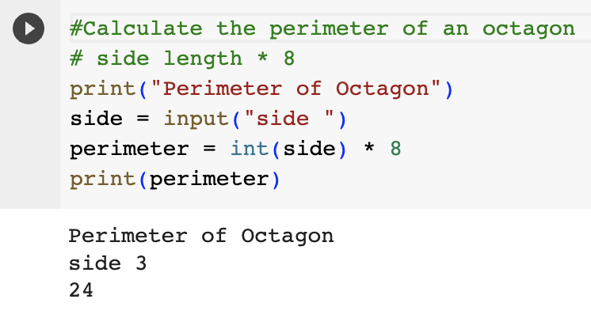
Problem 1: Perimeter of an Octagon
Notes:
WITH OLIVIA

Slide 8
Problem 2
Create a program that calculates the area of a trapezoid.
Notes:
WITH OLIVIA

Slide 9
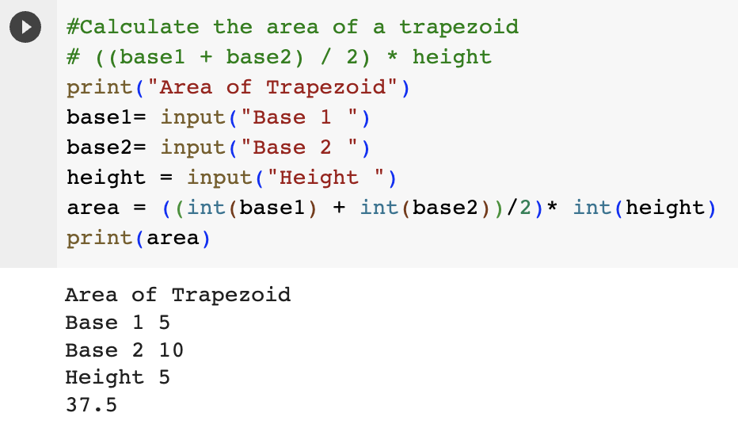
Problem 2: Area of a Trapezoid
Notes:
ON THEIR OWN

Slide 10
Problem 3
Create a program that determines the type of angle based on its measure.
Notes:
WITH OLIVIA

Slide 11
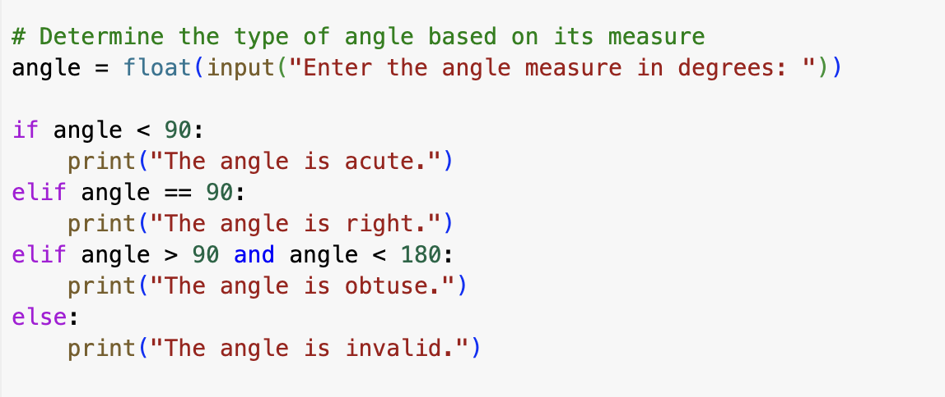
Problem 3: Determine Angle Type

Slide 12
Problem 4
Create a program that determines the shape of a triangle based on its side lengths.
Notes:
WITH OLIVIA

Slide 13
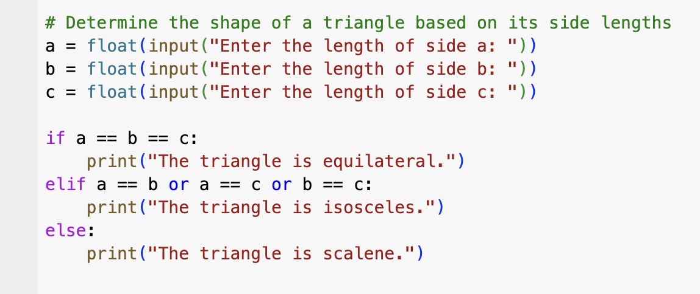
Problem 4: Determine Triangle Shape

Slide 14
Math Module
Python has a built-in module called math.
To use it, you must import the math module:
import math
When you have imported the math module, you can start using methods and constants of the module:
math.sqrt() returns the square root of a number
math.ceil() rounds a number upwards to its nearest integer
math.floor() rounds a number downwards to its nearest integer
math.pi returns the value of PI (3.14…)
math.cos() returns the cosine of a number
math.sin() returns the sine of a number

Slide 15
Problem 5
Create a program that converts degrees to radians.
Notes:
WITH OLIVIA

Slide 16
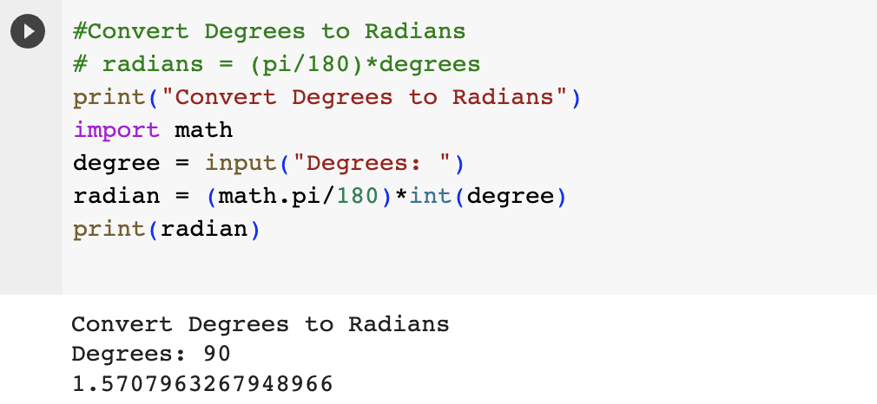
Problem 5: Convert Degrees to Radians
Notes:
WITH OLIVIA
If you want to calculate with Pi
# Import math Library
import math
# Value of pi
math.pi

Slide 17
Problem 6
Create a program that calculates solutions to the quadratic formula.
Notes:
WITH OLIVIA

Slide 18
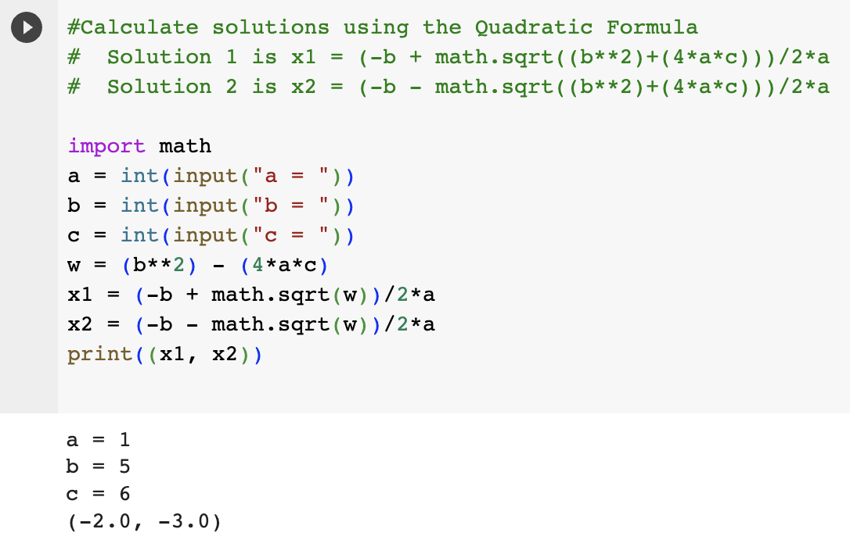
Problem 6: Quadratic Formula
Notes:
IF TIME ALLOWS (ON THEIR OWN)
If you want to square root
# Import math Library
import math
# Square root a value
math.sqrt()

Slide 19
Debugging Practice
Notes:
Doug

Slide 20
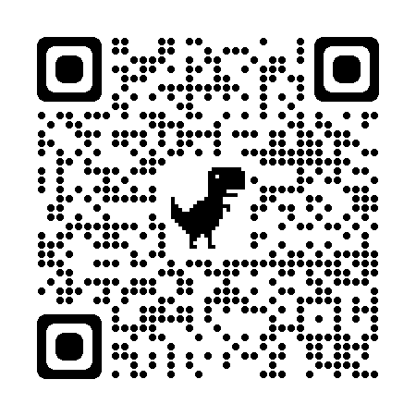
DEBUGGING
Now let’s try to debug some code and see if we can find the errors and correct them!
1. Find and Fix Syntax/Runtime Errors
2. Solve Logic Errors
Walk around the room to solve them OR test it on Google colab:
https://colab.research.google.com/drive/1O70USEiwymKrKa2QIkjEQ5F193U26MPO?usp=sharing
https://shorturl.at/tzJNQ

Slide 21
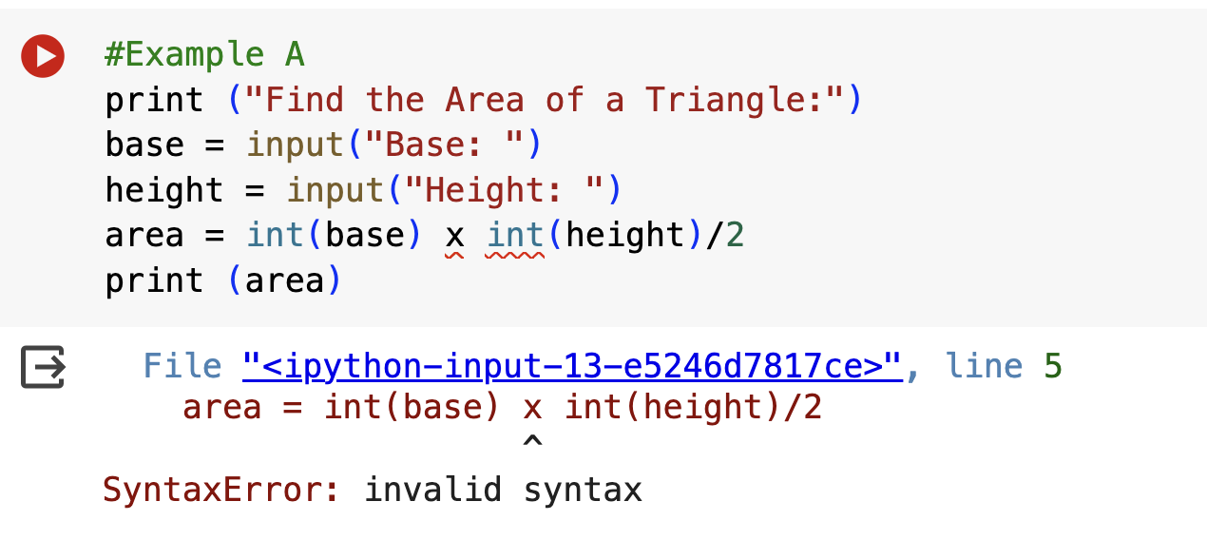
1. Find and Fix Syntax Error
A.

Slide 22
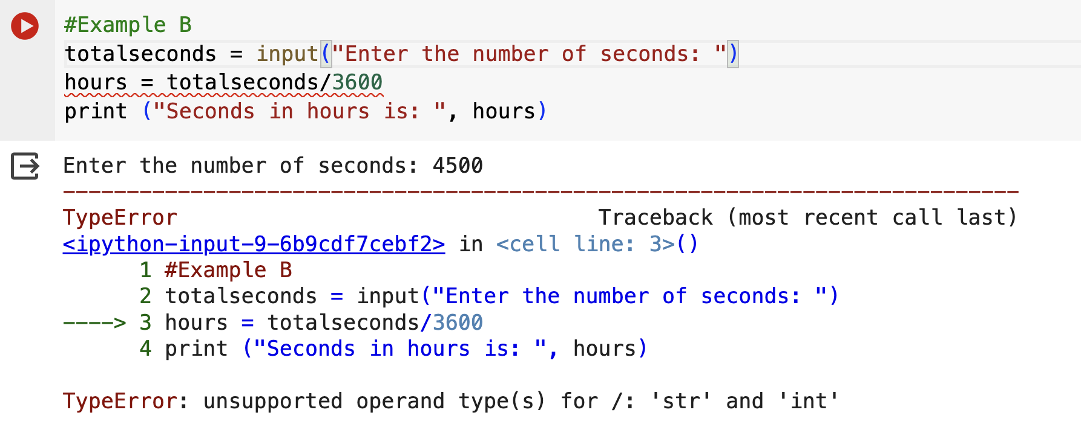
1. Find and Fix Type Error
B.

Slide 23
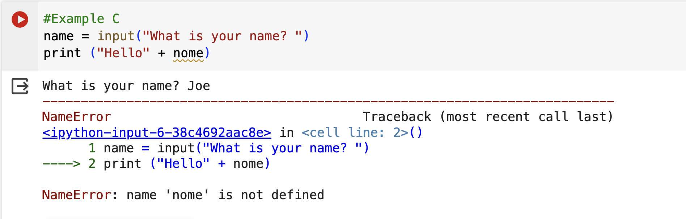
1. Find and Fix Name Error
C.

Slide 24
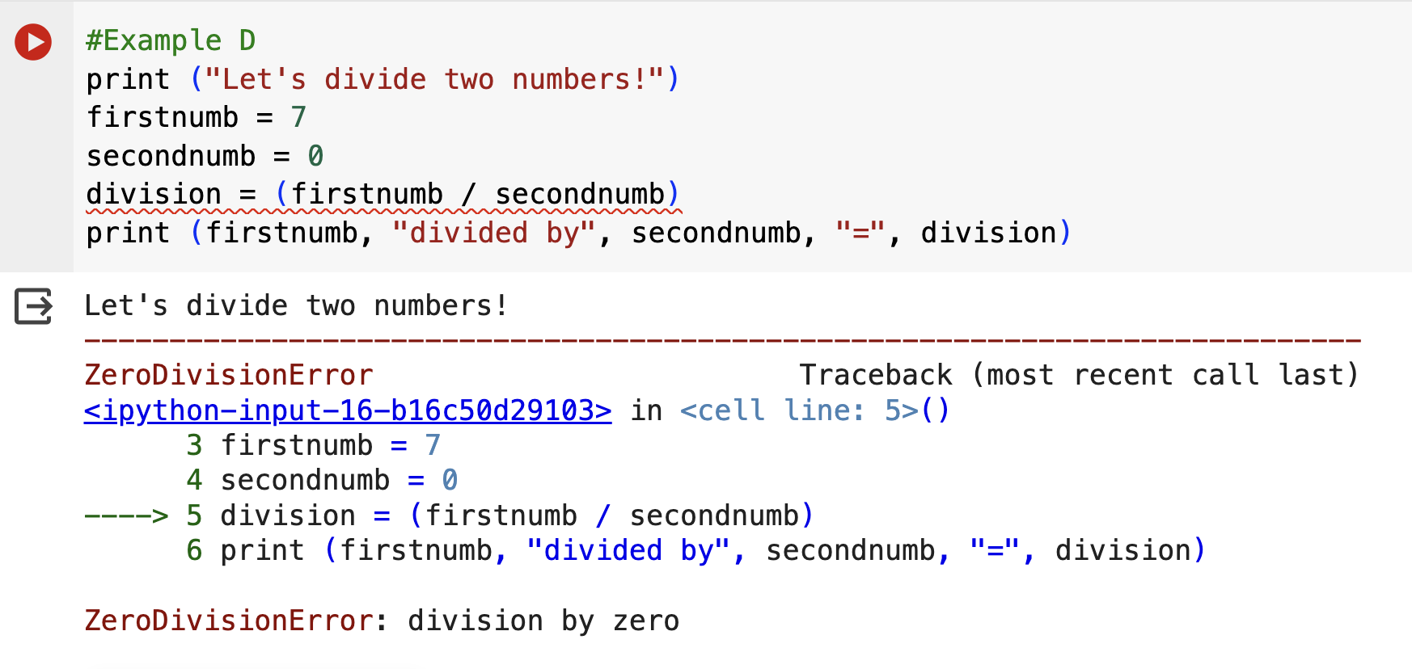
1. Find and Fix Runtime Error
D.

Slide 25
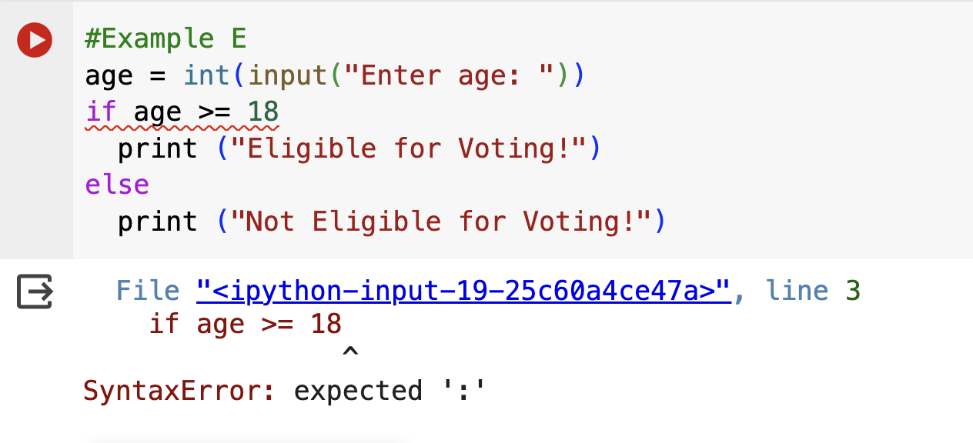
1. Find and Fix Syntax Errors
E.

Slide 26
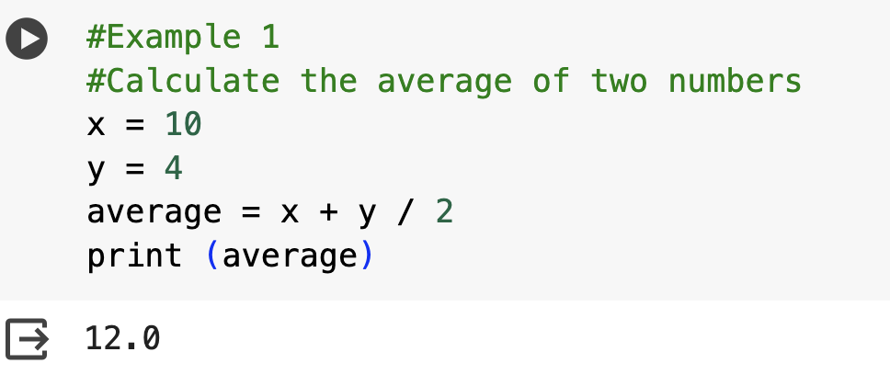
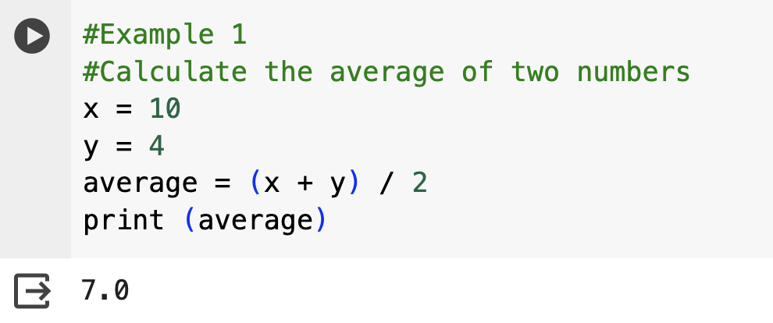
2A. Solve Logic Errors

Slide 27
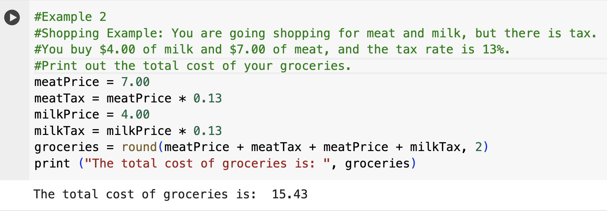
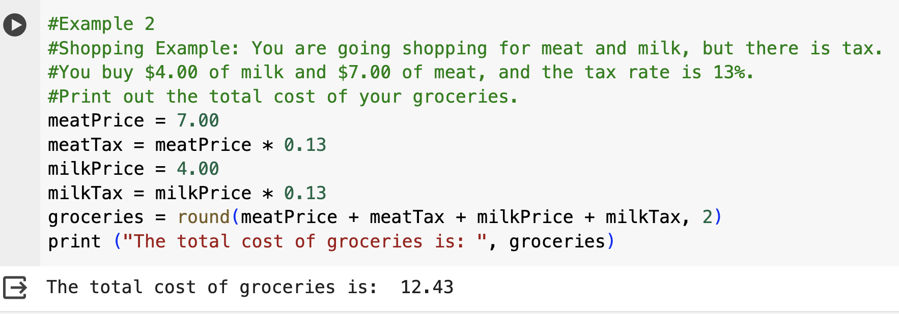
2B. Solve Logic Errors

Slide 28
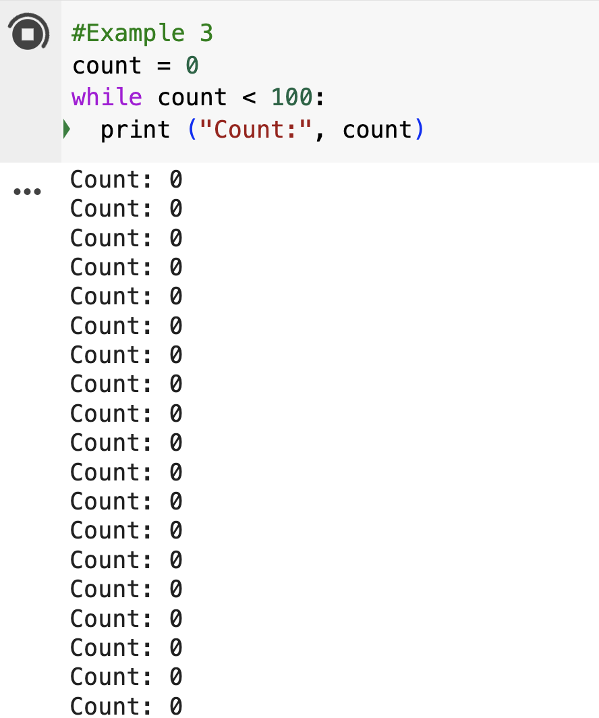
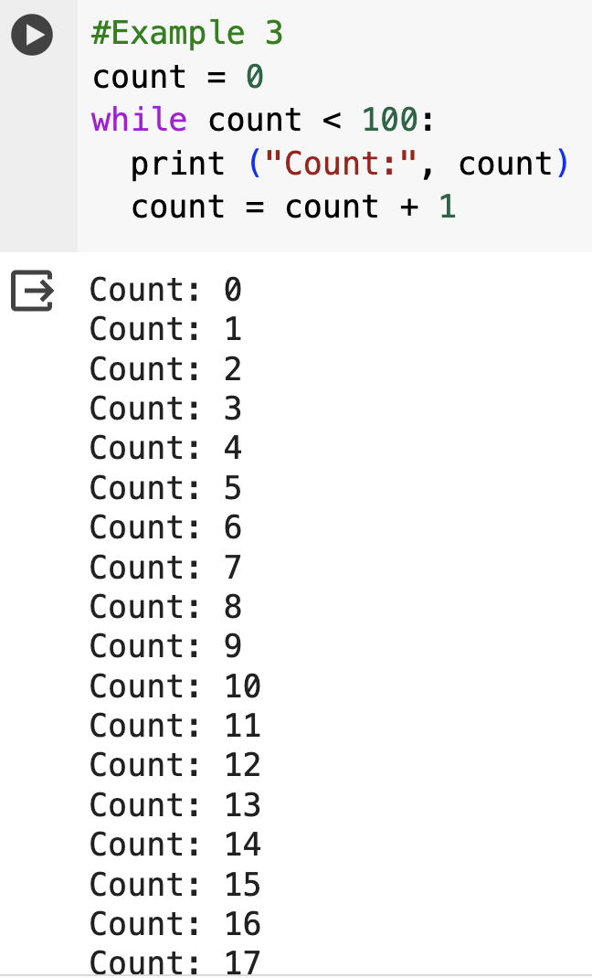
2C. Solve Logic Errors

Slide 29

Please return in 15 minutes. Enjoy the break!
☺☺☺

Slide 30
List
The lists are used to store an array of elements
nList
1
2
3
4
5
evenList
2
4
6
8
10
# To define a list
nList = [] evenList = []
# To store the numbers in the list
nList.append(n) evenList.append(even)

Slide 31
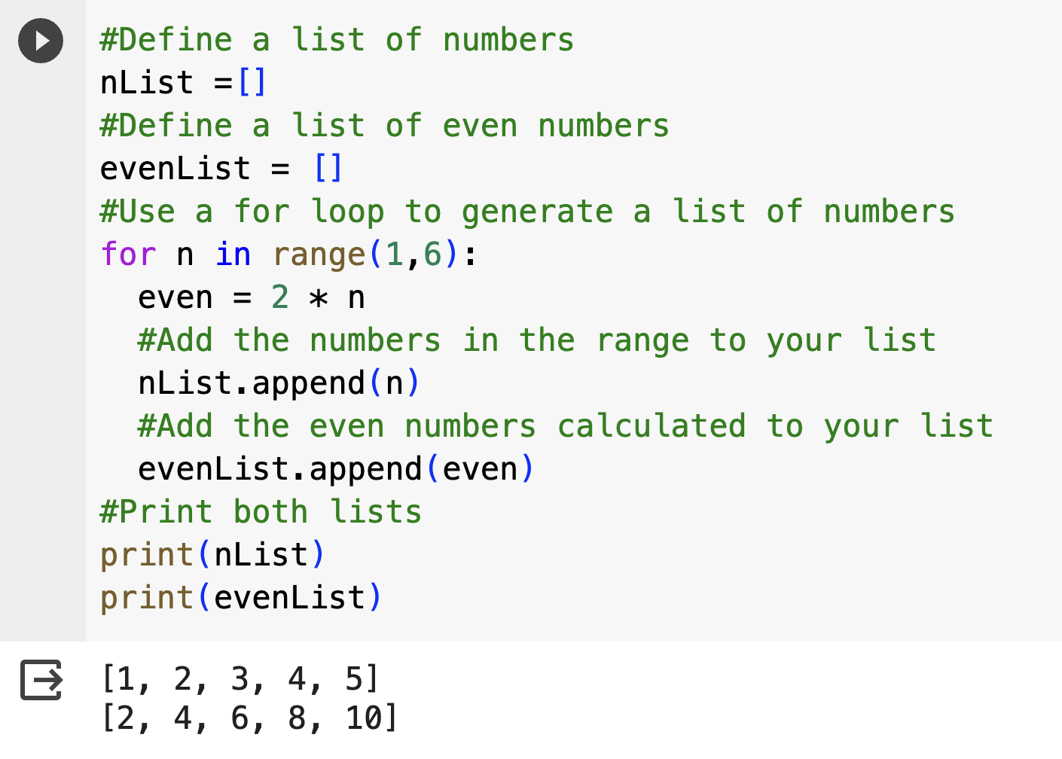
List

Slide 32
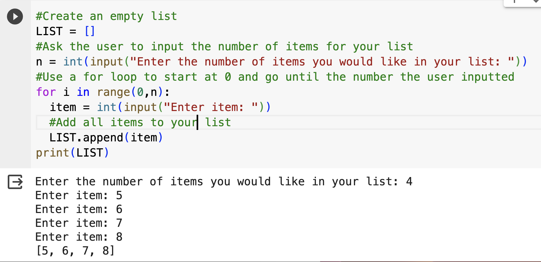
Input a list using a for loop

Slide 33
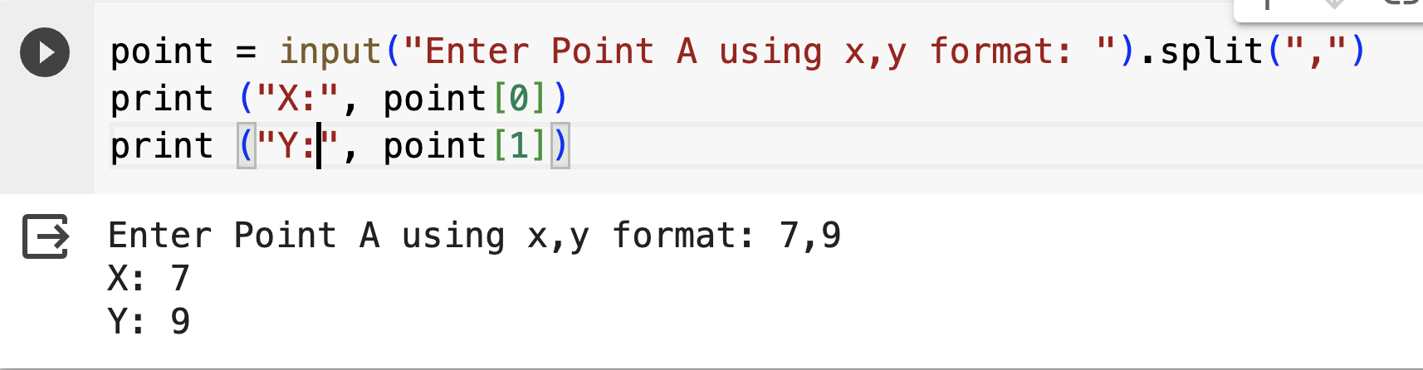
Using the .split() function

Slide 34
You try!
Ask the user to give you two points
Calculate the slope using the two points

Slide 35
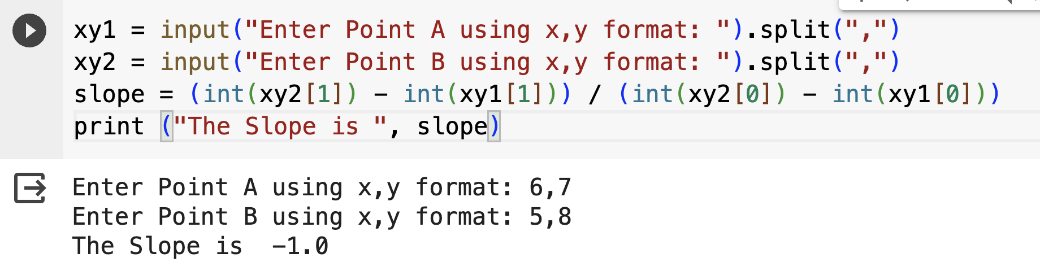
Calculate the Slope

Slide 36

Planning Session
With your school team, take this time to plan how you will incorporate coding into your lesson plans from this week to June.

Slide 37

TDSB Teacher Sharing Time
Come up and share with us any coding activities/lessons or experiences that you have integrated in your classroom
Notes:
Valbona links:
Financial literacy unit
https://colab.research.google.com/drive/1JqvuQBfSHq7tXdHDdrLpje3ikji-VbRY?usp=sharing
Intro to coding
https://colab.research.google.com/drive/1OMsnAyrkLgpFWaK_6Wnm8apeRd31PVmM?usp=sharing
Numbers and coding
https://colab.research.google.com/drive/1DxLevV5UJCJ9MTVzGqcKNjphfb-xmArD?usp=sharing

Slide 38
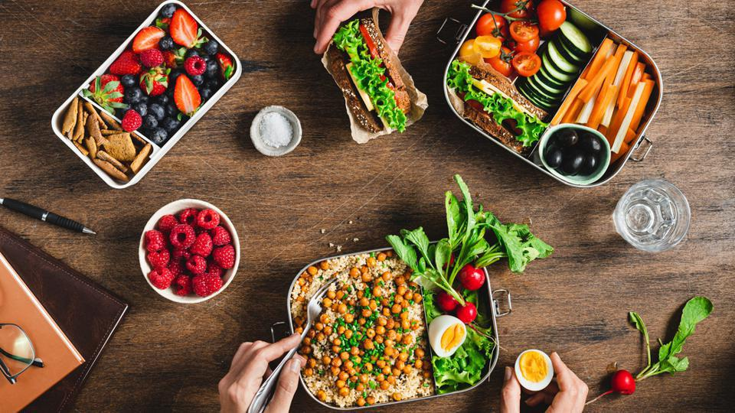
Please return in 1 hour.
Enjoy the break!
☺☺☺

Slide 39

Wipebook Chart Prize

Slide 40

Introduction to Graphs
Notes:
Olivia

Slide 41
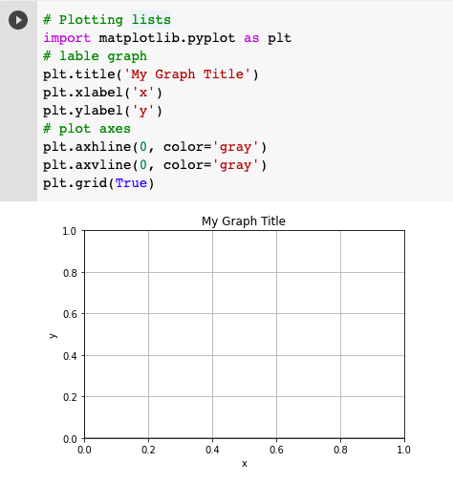
Graph
title
grid
ylabel
xlabel
Library to graph: matplotlib.pyplot
Notes:
https://www.geeksforgeeks.org/graph-plotting-in-python-set-1/

Slide 42
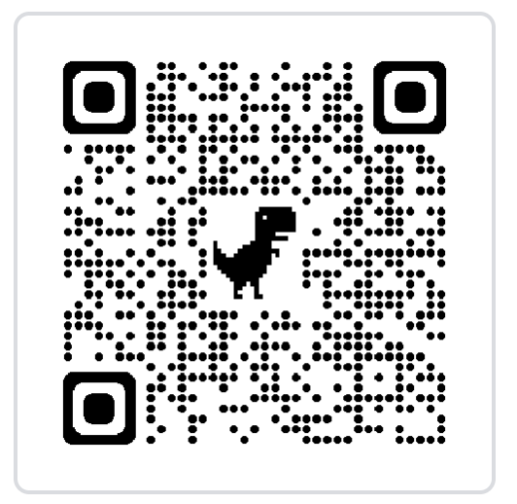
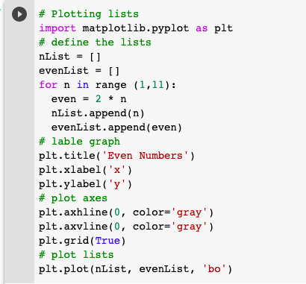
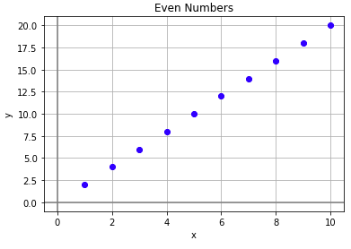
Practice Graphing!
https://www.geeksforgeeks.org/matplotlib-tutorial/?ref=shm
https://shorturl.at/gozMN
Notes:
https://www.geeksforgeeks.org/matplotlib-tutorial/?ref=shm

Slide 43
Practice Time
Notes:
Olivia

Slide 44
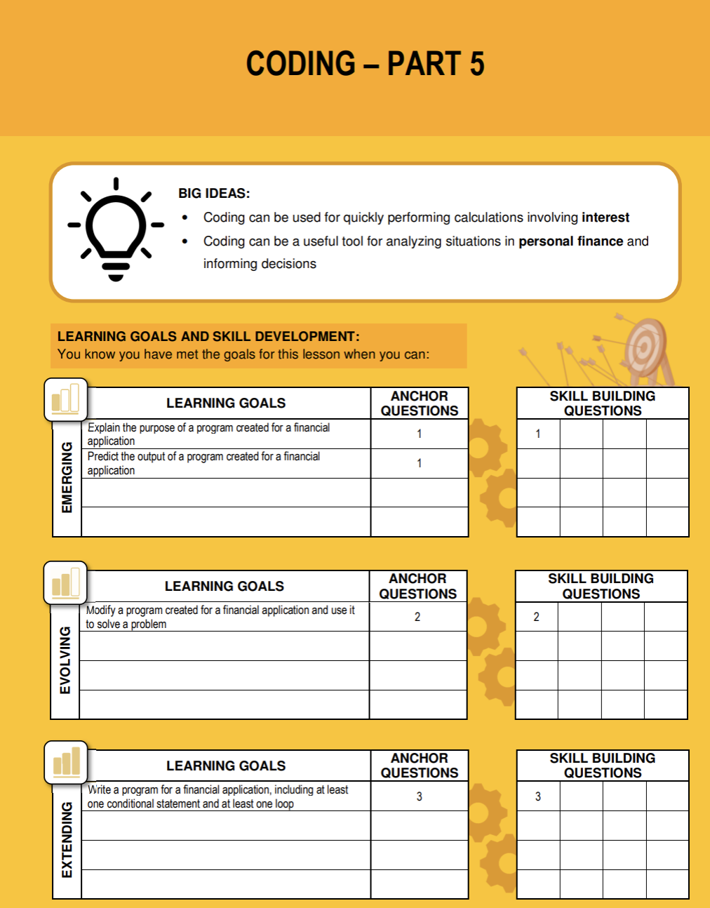
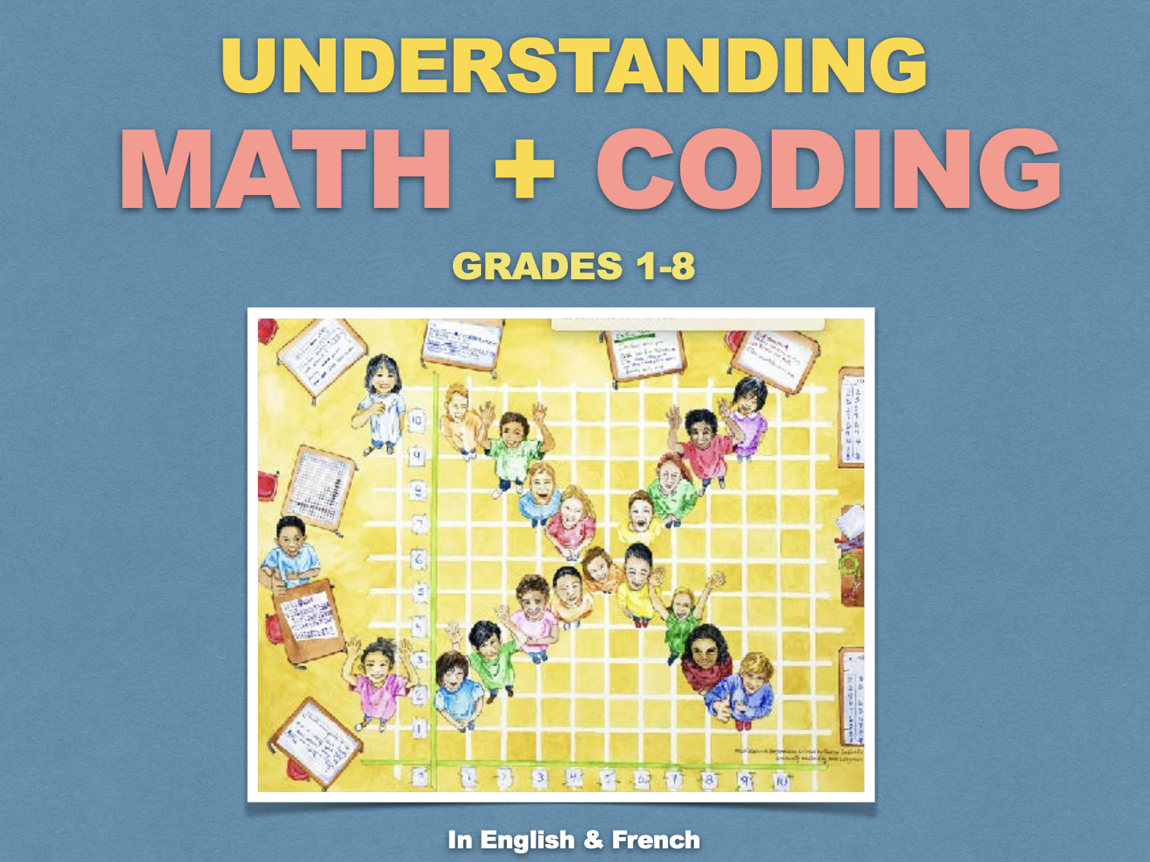

Resources
TVO Learn: https://tvolearn.com/products/mth1w-mathematics
&

Slide 45
Practice Time
You can start with this question or others from your resources:
Question 1: You found 18 metres of fencing in your shed. You want to use this fencing to enclose a garden to keep bunnies out. List all the possible lengths (from 1 to 8) and areas, all with a perimeter of 18m.

Slide 46
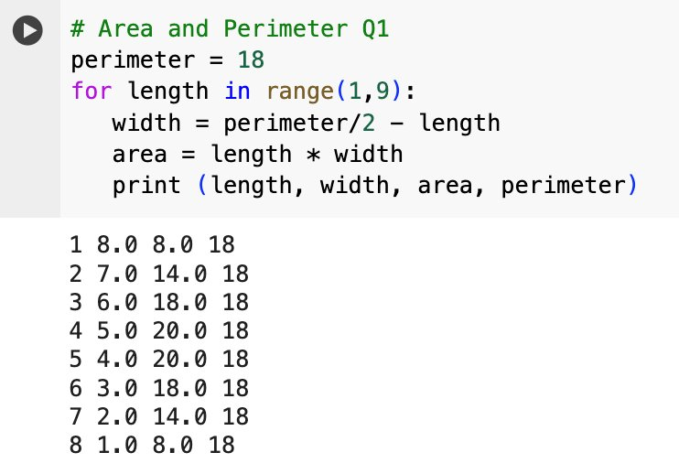
Question 1

Slide 47
Question 2
(Sample Task #1 Ontario Curriculum)
Have students write code to generate the first 100 prime numbers.

Slide 48
Generate the first 100 prime numbers
To verify if a number is prime, obtain the remainder of the number divided by all the numbers between 2 and the number – 1
If all the remainders are not zero, the number is prime
If one remainder is zero, this number is not prime, then check the next number
Count the number of prime numbers found
Stop when the count is 100

Slide 49
Find the first 100 prime numbers
count = 0
n = 2
No
count <= 100
Yes
x = 2
x < n
No
Yes
r = n % x
r ==0
No
Yes
x ==n
No
x = x + 1
Yes
n is prime
End
count = count + 1
n = n+ 1

Slide 50
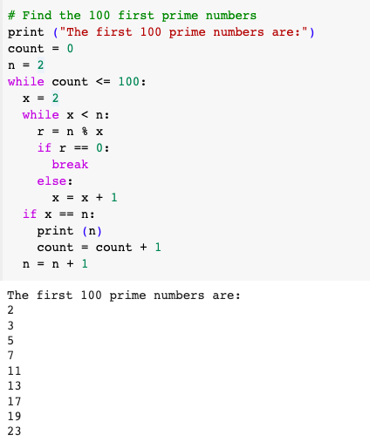

Slide 51


Focus Groups

Slide 52
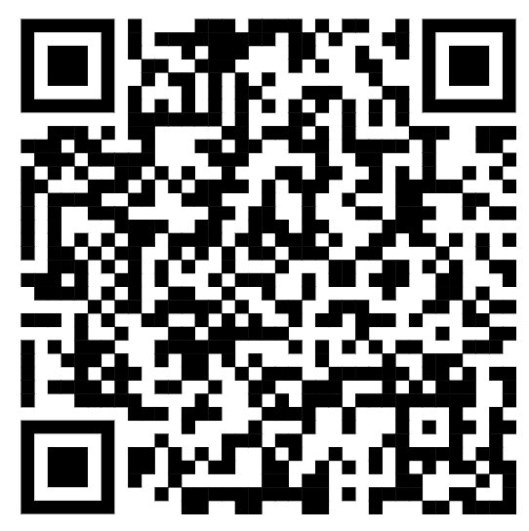
Focus Groups
https://forms.gle/fPPc2fEPWFZNpvtP7
Please fill out the consent form if you have not done so before.

Slide 53
Focus Group
Can you please share some examples of how you have incorporated technology, coding, and/or AI in your classroom?
What have been the highlights from these four professional learning sessions?
What supports do you still need in order to continue your integration of coding in your mathematics classroom?

Slide 54
Concluding Remarks

Slide 55
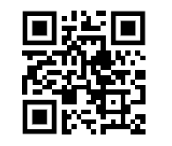
Before you go…
Exit ticket: Google Form on today’s session
https://shorturl.at/bmFU2
Notes:
https://forms.gle/cojEr7r5NPUKDinL9

